Slide 1
MIPS
Instruction Set Architecture
19CSE211 COA
Session 6
21-01-2021

Slide 2
Recap of Session 5
H.C. TD5102

Slide 3
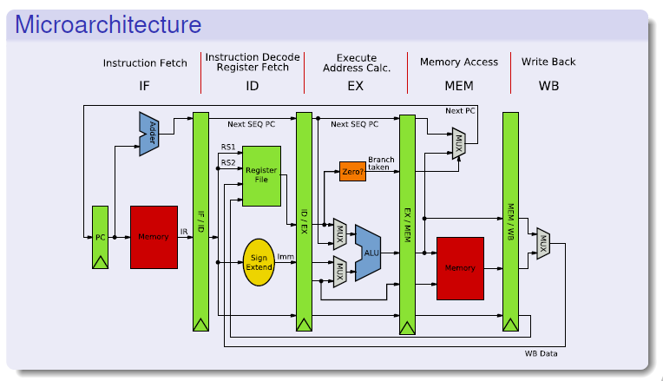
H.C. TD5102

Slide 4
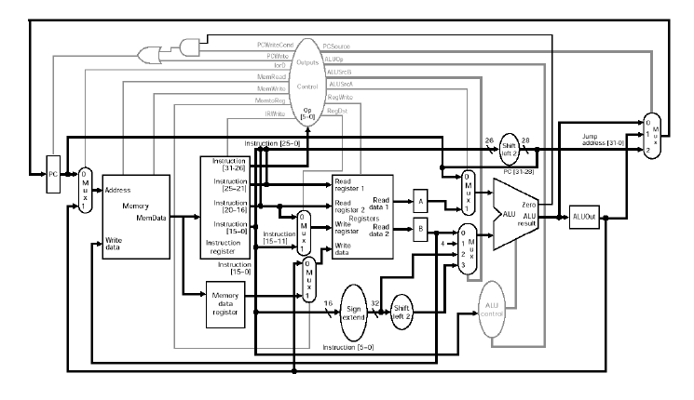
MIPS Data path with Control Signals
H.C. TD5102

Slide 5
MIPS - ISA
H.C. TD5102

Slide 6
Main Types of Instructions
Arithmetic
  Integer
  Floating Point
Memory access instructions
  Load & Store
Control flow
  Jump
  Conditional Branch
  Call & Return
H.C. TD5102

Slide 7
MIPS arithmetic
Most instructions have 3 operands
Operand order is fixed (destination first)
Example:
C code: A = B + C
MIPS code: ????????????
H.C. TD5102

Slide 8
MIPS arithmetic
Most instructions have 3 operands
Operand order is fixed (destination first)
Example:
C code: A = B + C
MIPS code: add $s0, $s1, $s2
($s0, $s1 and $s2 are associated with variables by compiler)
H.C. TD5102

Slide 9
MIPS arithmetic
C code: A = B + C + D;
E = F - A;
MIPS code: ???????
Operands must be registers, only 32 registers provided
H.C. TD5102

Slide 10
MIPS arithmetic
C code: A = B + C + D;
E = F - A;
MIPS code: add $t0, $s1, $s2
add $s0, $t0, $s3
sub $s4, $s5, $s0
Operands must be registers, only 32 registers provided
Design Principle: smaller is faster. Why?
H.C. TD5102

Slide 11
Registers vs. Memory
Arithmetic instruction operands must be registers,
— only 32 registers provided
Compiler associates variables with registers
What about programs with lots of variables ?
Memory
CPU
register file
IO
H.C. TD5102

Slide 12
Register allocation
Compiler tries to keep as many variables in registers as possible
Some variables can not be allocated
  large arrays (too few registers)
  aliased variables (variables accessible through pointers in C)
  dynamic allocated variables
    heap
    stack
Compiler may run out of registers => spilling
H.C. TD5102

Slide 13
Memory Organization
Viewed as a large, single-dimension array, with an address
A memory address is an index into the array
"Byte addressing" means that successive addresses are one byte apart
0
8 bits of data
1
8 bits of data
2
8 bits of data
3
8 bits of data
4
8 bits of data
5
8 bits of data
6
8 bits of data
...
H.C. TD5102

Slide 14
Memory Organization
Bytes are nice, but most data items use larger "words"
For MIPS, a word is 32 bits or 4 bytes.
2³² bytes with byte addresses from 0 to 2³²-1
2³⁰ words with byte addresses 0, 4, 8, ... 2³²-4
0
32 bits of data
4
Registers hold 32 bits of data
32 bits of data
8
32 bits of data
...
12
32 bits of data
H.C. TD5102

Slide 15
Memory layout: Alignment
31
23
15
7
0
0
this word is aligned; the others are not!
4
8
12
address
16
20
24
Words are aligned
What are the least 2 significant bits of a word address?
H.C. TD5102

Slide 16
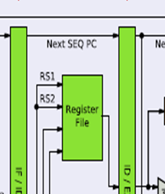
What about Register file ???
H.C. TD5102

Slide 17
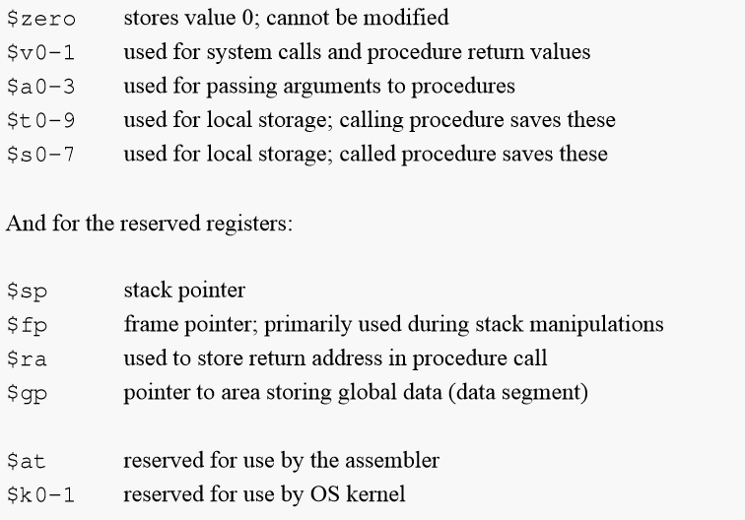
Used MIPS Conventions
32 Registers each of 32 bits
H.C. TD5102

Slide 18
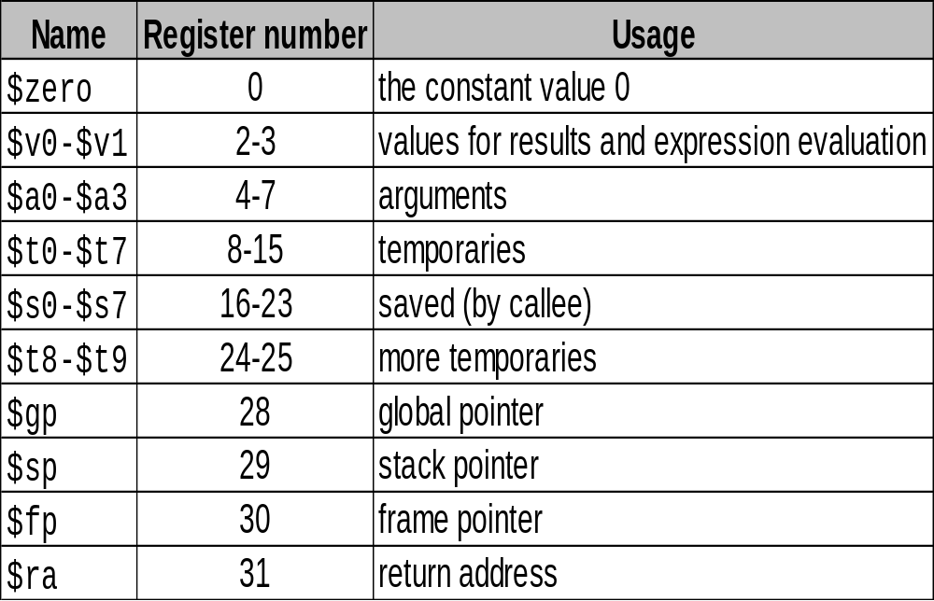
Used MIPS Conventions
$at – Reg No 1 – Reserved for Assembler
$k0, $k1 – Reserved for Operating System
H.C. TD5102

Slide 19
Addressing Modes
Addressing modes are an aspect of the instruction set architecture in most CPU designs.
The various addressing modes that are defined in a given instruction set architecture define how the machine language instructions in that architecture identify the operand(s) of each instruction.
An addressing mode specifies how to calculate the effective memory address of an operand by using information held in registers and/or constants contained within a machine instruction or elsewhere.
In computer programming, addressing modes are primarily of interest to those who write in assembly languages and to compiler writers.
H.C. TD5102

Slide 20
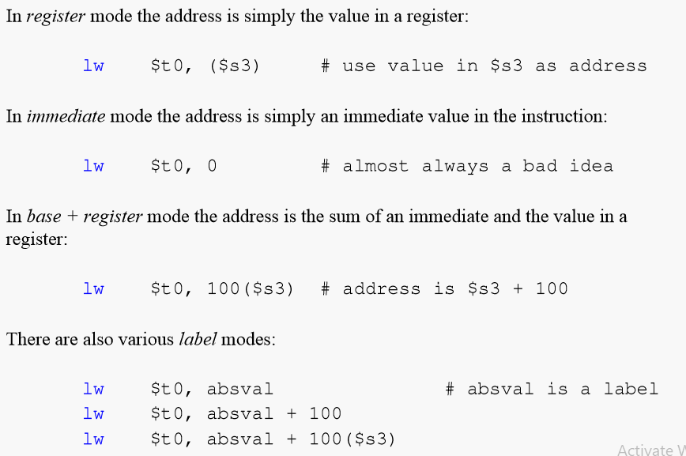
H.C. TD5102

Slide 21
MIPS
Instruction Set Architecture
Courtesy: Henk Corporaal
http://www.ics.ele.tue.nl/~heco/courses/EmbSystems
Technical University Eindhoven
DTI / NUS Singapore

